Slide 1
Doctor Appointment And Recommendation System
Ankit Budhathoki 15454
Ashbin Thapa 15455

Slide 2
Presentation Overview
Introduction
Problem Definition
Objective
Literature Review
Methodology
Tools Used
Working Division
Project Deliverables
ER Diagram
Use Case Diagram
Conclusion

Slide 3
Introduction
Doctor Recommendation System is developed to override the problems prevailing in the practicing manual system
System is designed for the particular need of the company to carry out operations in a smooth and effective manner
No formal knowledge is required for the users to use this system which makes it more user-friendly
Assist the users to concentrate on their other activities rather to rather to concentrate on the patient’s record keeping

Slide 4
Problem Definition
Inefficient and time-consuming process of scheduling medical appointments.
Long waiting times and have difficulty getting in touch with medical professionals for follow-up by patients
Challenge of managing their busy schedules, tracking patient appointments, and accessing patient information in a timely and accurate manner by Medical Professionals

Slide 5
Objective
To develop a web application with admin, patient, and doctor panel,
Enhancing patient satisfaction by providing recommendations of doctors,
To increase efficiency of managing the records of doctors and patients,
To enhance the recommendation model using symptoms filtering.

Slide 6
Literature Review
Although the conceptualization of doctor recommendation and appointment system is in initial phase, there are multiple literature showcasing the use collaborative filtering for recommendation in various aspects:
Better Doctor.[1] is an online platform that allows patients to search for healthcare providers and book appointments with them. The platform uses data from government and healthcare sources to provide accurate and up-to-date information about healthcare providers.
Health grades.[2] is an online platform that allows patients to search for and review healthcare providers based on their specialty, location, and patient reviews. Patients can also book appointments with healthcare providers through the platform
Notes:
Crop Management
• Water Monitoring
• Soil Monitoring (pH, Humidity, Salinity, Temperature)
• Crop Monitoring (Pest Detection, Photosynthesis, Weed Detection)
• Disease Prediction
Livestock Monitoring
• Disease Prediction
• Location Tracking
Remote Sensing
• Field Monitoring
• Unmanned Aerial Vehicle (UAV)
• Weather Monitoring
Supply Chain Management
• benefiting from agriculture marketing where Farmers can use the facilities of smart agriculture for selling their product directly to the consumer.

Slide 7
Methodology
We have worked on these methodologies for the application of knowledge, skills and technique to broad range of activities in order to meet the requirement of our project. To complete this project, the following methodology / process has been conquered:
SOFTWARE DEVELOPMENT LIFE CYCLE
Model to be used for developing of this project is Iterative model
It is simple and emphasizes on initial and simple implementation and with progress in the project it gains more feature
It is advantageous since it has unique feature of repetitive nature i.e. during development phase one can go back to check out the previous works without any complications and flaws can be improved

Slide 8
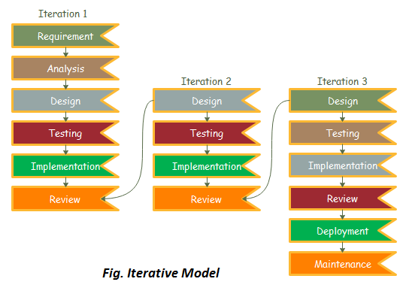

Slide 9
Tools Used
Tools | Purpose
PHP | Whole application base creation platform
GitHub | To manage Source Code
Adobe Photoshop CS6 | For editing pictures
Web Browser | For running the application
Xampp | For running database

Slide 10
Work Division
SN | NAME | ROLES | RESPONSIBILITIES
1 | Ashbin Thapa | Backend Developer, Tester, Documentation Writer | Built and maintain database and logic, Identify and report bugs, ensuring it meets the desired quality, Create and maintain technical documentation.
2 | Ankit Budhathoki | Frontend Developer, Tester, Project Manager | Develop and maintain the user facing aspects, Review and approve project deliverables, Plan, execute and oversee the development and delivery of the project, ensuring it meets the project requirements, timeline, and budget.

Slide 11
Project Deliverables
Build web application with interface for patient, doctor, and admin,
Recommend doctor schedule for patient according to selected symptoms,
Admin control of doctor sessions and appointments,
Admin can manage doctor schedule i.e. addition and deletion of doctor schedule which include doctor fee, hospital, and date and time,
Patient can view the list of all doctors and check if their sessions are available or not,
Patient can see their bookings and pay through khalti.

Slide 12
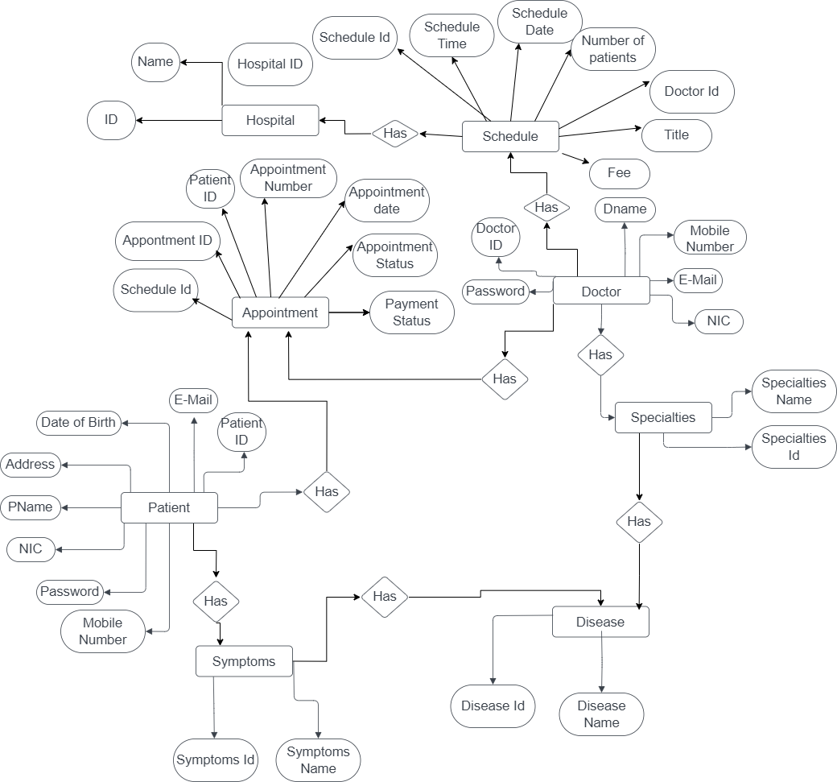
ER Diagram

Slide 13
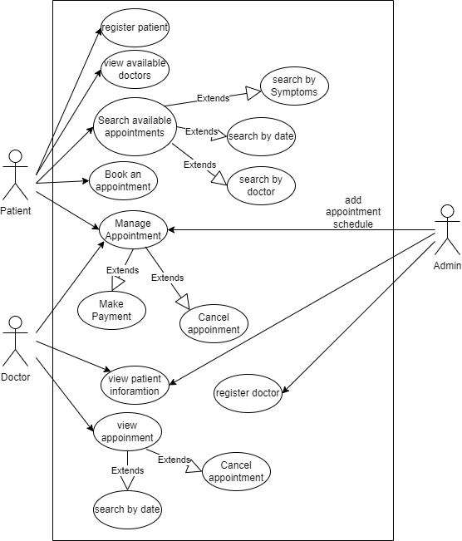
Use Case Diagram

Slide 14
Conclusion
Doctor Recommendation System is an efficient and effective solution for managing healthcare services, improving patient care, and enhancing doctor recommendation. It provides a user-friendly interface for patients, doctors, and administrators to interact with the system and access the information they need. This system can greatly benefit healthcare organizations by increasing their efficiency, improving their service quality, and ultimately leading to better health outcomes for patients.

Slide 15
REFERENCES
[1] S. Indhumathi, G. vijayabaskar (2015)http://nevonprojects.com/clinic-management-system/.
[2] Quora. Retrieved from The Pros & Cons of using ZocDoc Answers: https://www.quora.com/What-are-the-pros-and-cons-of-using-ZocDoc-to-make-doctor-appointments
[3] Quora. How-much-do-you-value-reviews-ZocDoc-HealthGrades-etc-versus-a-personal-recommendation-when-selecting-a-doctor https://www.quora.com/How-much-do-you-value-reviews-ZocDoc-HealthGrades-etc-versus-a-personal-recommendation-when-selecting-a-doctor
[4] 29 May 2021 . Healthgrades application review https://www.apppicker.com/reviews/12416/healthgrades-app-review
[5] https://codecanyon.net/item/quick-media-hospitalclinic-management-system/12088123.
[6]http://afiinfotech.com/online_clinic_management_system_software.

Slide 16
THANK YOU

